Slide 1

DETECTING LUNG AND COLON CANCER USING CNN
Under The Supervision of
Mrs. SK. Mulla Almas M.Tech
Assistant Professor
Presented By
PASUPULETI NARASIMHA - 20BQ1A12C5
JAVVAJI LIKHITH CHOWDARY -20BQ1A1268
JONNALAGADDA VIJAY KUMAR - 21BQ5A1213
KORLAKUNTA TRIVENU - 20BQ1A1286
Department of Information Technology
Vasireddy Venkatadri Institute of Technology
Padakakani Mandal, Namburu, Gunturu-522508

Slide 2
Contents Outline
Abstract
Introduction and Literature Survey
Existing System with Architecture
Proposed System Architecture with Advantages
Proposed System Objectives
Hardware and Software Requirements
Proposed System Design & Implementation
7.1. Design
7.2. Implementation
Evaluation/Testing
Outputs/Results
Conclusion
Future Enhancement
References
Queries & Thankyou

Slide 3
Abstract
Cancer is a lethal condition brought on by a confluence of hereditary disorders and several metabolic anomalies. The two main causes of death and disability in people today are lung and colon cancer. The most crucial factor in choosing the optimal course of action is typically the histopathological detection of such cancers. The chance of death is significantly reduced by early diagnosis of the illness on either front. Such cancer diagnosis can be accelerated using machine learning and deep learning approaches, enabling researchers to analyze a large number of patients in a much less time and at a lower cost. To effectively identify lung and colon cancer, we developed a hybrid ensemble feature extraction model using CNN(Convolutional Neural Networks). For cancer image datasets, it combines deep feature extraction and ensemble learning with high-performance filtering.
These models can therefore be used in clinics to assist doctors in making cancer diagnosis.

Slide 4
Introduction and Literature Survey
A wide range of disorders that can harm human organs fall under the umbrella term of "cancer."
It is also a rapid reaction of aberrant cells that expand beyond their acceptable boundaries, allowing them to infect neighboring areas and travel to neighboring tissues which is known as metastasis.
Metastasis is the prime factor of cancer-related death (Organization, 2022). The disease’s prevalence has risen significantly over time, most likely as a result of increased sensitivity to particular cancers as age advances.
Colorectal cancer, which affects the colon and rectum, is one of the major induces of death.
Although colorectal cancer, which affects the colon and rectum, is the main cause of death (10.7%), lung cancer is likely the most frequently recognized malignancy (12.2%) (Lyon, 2020). Although its effects are not uniformly spread, it is one of the primary causes of fatalities worldwide.

Slide 5
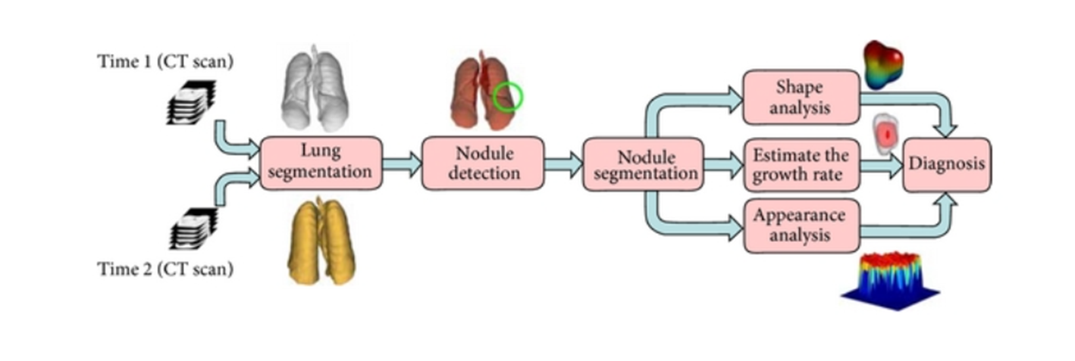
Existing System with Architecture
Lung and colon cancer using computer-aided diagnosis (CAD) approach
A CAD method was introduced by (Nishio) to categorize histopathology images of lung tissues automatically.
They evaluated the effectiveness of ML algorithms on two datasets using traditional texture analysis (TA) and homology-based image processing (HI) for visual feature extraction. The CAD system with HI outperformed the TA system in both datasets.
For reference Computer-Aided Diagnosis Systems for Lung Cancer

Slide 6
Existing System Disadvantages
The CAD method using traditional texture analysis (TA) shows less accuracy compared to the CNN approach, which leads to poor outcomes for the majority of patients (false negative rate).
Another drawback is the inability of a technique to segment the challenging and special types of cancer, and the automation level of the technique and its robustness.

Slide 7
Proposed System Architecture with Advantages
In the suggested model, we employ a hybrid approach that combines CNN model with Optimizer methods.
Image pre-processing, deep feature extraction, optimizer, and confusion matrix have all been discussed.
We also provide a fundamental CNN algorithm with an optimizer, which is utilized to effectively detect lung and colon cancer.
Advantages
Early Cancer Detection : The proposed model using feature extraction and CNN algorithm on LC25000 lung and colon histopathological image datasets to assure a prognosis of lung and colon cancer.
Enhanced Diagnostic Accuracy : Improves the accuracy of cancer classification through machine learning techniques, reducing the risk of misdiagnosis.
Time and Cost Efficient : It enables less amount of time and low budget for the recovery of patients.
Fast performance : The System supports Fast performance because of Histopathology.

Slide 8
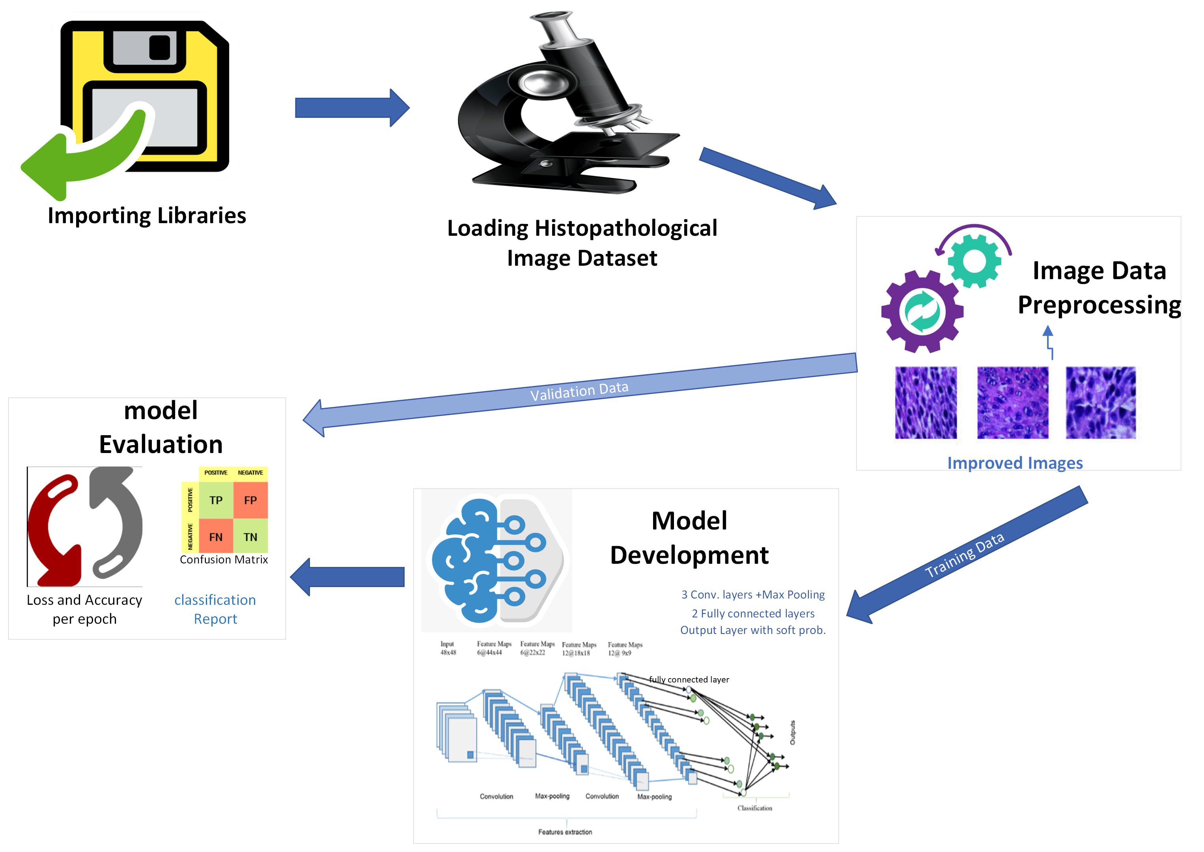
Proposed System Architecture

Slide 9
Proposed System Objectives
Automation: Efficient and rapid analysis of medical images, reducing the time and effort required for manual examination for detecting Lung and Colon Cancer.
Supporting Healthcare Professionals : Provide a tool to support radiologists and medical practitioners in making more informed and efficient diagnostic decisions.
Advancing Medical Research : Contribute to the field of medical image analysis, fostering advancements in deep learning applications for healthcare.
Scalability and Future-Proofing : Design the system to be scalable and adaptable to meet evolving healthcare needs.
Reducing Human Error : Minimize the potential for human error in the cancer diagnosis process.

Slide 10
Hardware and Software Requirements
Hardware Requirements
Disk Storage : 1TB HDD or 256GB SSD
Ram : 4GB or above
Processor : i3 or above
Software Requirements
Operating System : Microsoft Windows 08 or above
Code Editor : Saturn Cloud
Languages : Python 3.7 or above
Libraries : Pandas, Numpy, Matplotlib, Keras, Scikit-learn

Slide 11
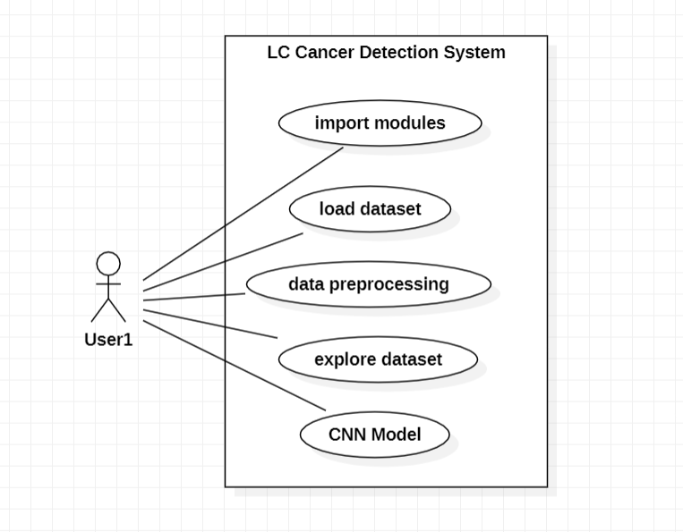
Proposed System Design
Usecase Diagram

Slide 12
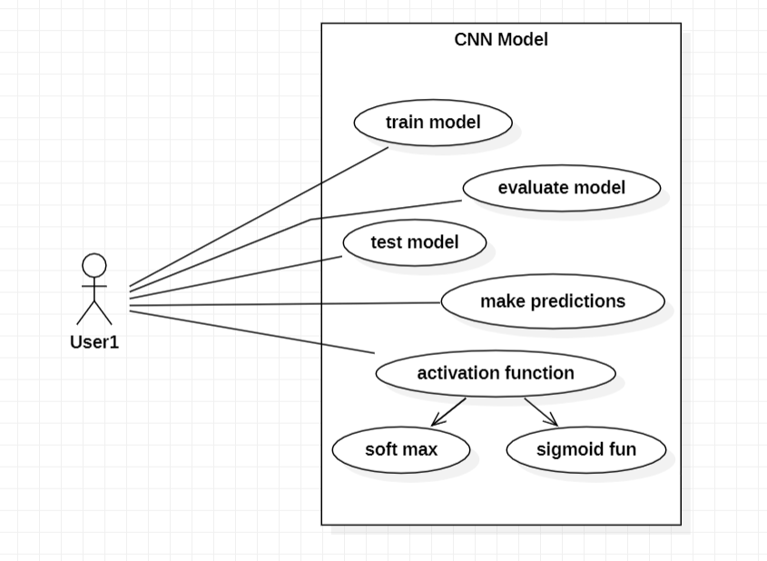
Proposed System Design
Usecase Diagram

Slide 13
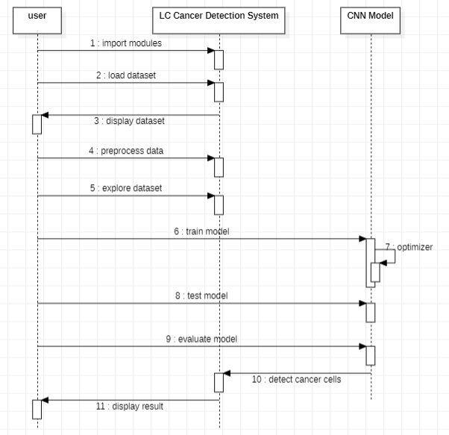
Proposed System Design
Sequence Diagram

Slide 14
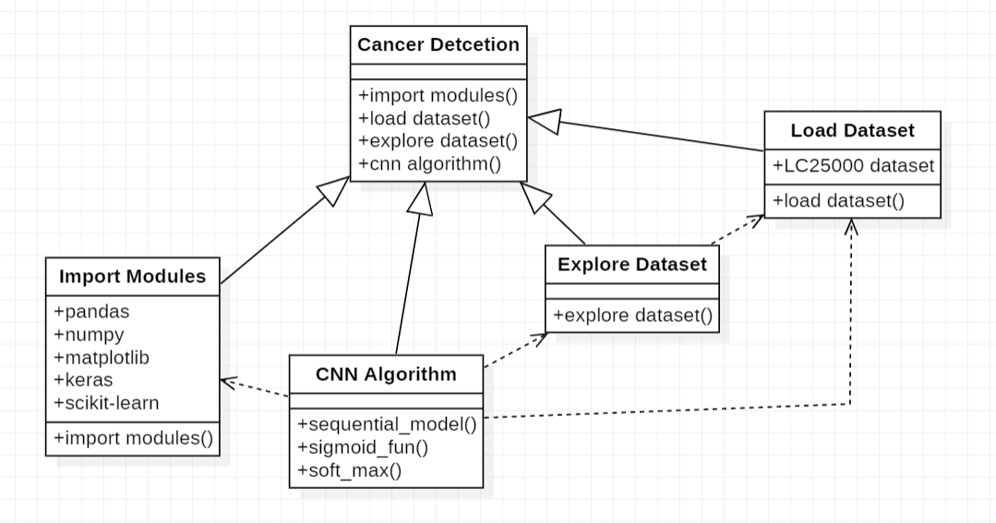
Proposed System Design
Class Diagram

Slide 15
Implementation
Module 1: Data Acquisition
Responsible for downloading the dataset from Kaggle using the Kaggle API. It acquires the necessary data for training and testing.
Code: Kaggle API for dataset retrieval.
Module 2: Data Preprocessing
Handles image preprocessing tasks such as resizing and normalization using OpenCV and NumPy. This prepares the data for model training.
Code: Image resizing, normalization.
Module 3: Data Splitting
Focuses on splitting the dataset into training and testing sets, a critical step for assessing the model's performance.
Code: Data splitting using scikit-learn.
Module 4: Model Development
Defines the architecture of the Convolutional Neural Network (CNN) using TensorFlow and Keras. This module lays the foundation for the model’s structure.
Code: Create layers, convolution, and pooling.

Slide 16
Implementation
Module 5: Model Training
Compiles and trains the CNN model on the training dataset, allowing it to learn and adapt to the data.
Code: Model compilation and training using TensorFlow and Keras.
Module 6: Model Evaluation
Assesses the model's performance on both training and testing datasets, providing insights into its accuracy and generalization capabilities.
Code: Evaluate the model's performance on training and testing datasets.
Module 7: Result Analysis
Analyzes the model's outputs, calculates relevant metrics, and interprets the findings, helping to understand its performance.
Code: Analyze model results, calculate metrics, and interpret findings.
Module 8: Model Usage
Demonstrates how to utilize the trained model for making predictions on sample images, showcasing its practical application.
Code: Utilize the trained model to make predictions on sample images.

Slide 17
Implementation
Module 1: Data Acquisition
Module 2: Data Preprocessing
# Set up Kaggle configuration
os.environ['KAGGLE_CONFIG_DIR'] = '/content'
# Download the dataset
!kaggle datasets download –d andrewmvd/lung-and-colon-cancer-histopathological-images
# Import relevant libraries
import cv2
from tqdm import tqdm
# Loop through the dataset directories and preprocess images
features = []
for dir in os.listdir(loc1):
sub_dir = os.path.join(loc1, dir)
for img in tqdm(os.listdir(sub_dir)):
f = cv2.imread(os.path.join(sub_dir, img))
f = cv2.resize(f, (70, 70))
features.append(f)

Slide 18
Implementation
Module 3: Data Splitting
Module 4: Model Development
# Import train_test_split from scikit-learn
from sklearn.model_selection import train_test_split
# Split the data into training and testing sets
xtrain, xtest, ytrain, ytest = train_test_split(X, Y)
# Import relevant libraries
from keras import layers, models, regularizers
# Define the CNN model
model = models.Sequential()
model.add(layers.Conv2D(32, (3, 3), padding='same', input_shape=(70, 70, 3))
model.add(layers.Activation('relu'))
# Add more layers: Conv2D, MaxPooling2D, etc.

Slide 19
Implementation
Module 5: Model Training
Module 4: Model Development
# Compile and train the model
model.compile(loss='categorical_crossentropy', optimizer=sgd, metrics=['accuracy'])
model.fit(xtrain, ytrain, epochs=20, validation_data=(xtest, ytest))
# Import relevant libraries
from keras import layers, models, regularizers
# Define the CNN model
model = models.Sequential()
model.add(layers.Conv2D(32, (3, 3), padding='same', input_shape=(70, 70, 3))
model.add(layers.Activation('relu'))
# Add more layers: Conv2D, MaxPooling2D, etc.

Slide 20
SOFTWARE AND HARDWARE COMPONENTS
Software Tools
Deep Learning Framework: TensorFlow and Keras for building and training the model.
Data Preprocessing: OpenCV for image processing, NumPy for array operations.
Data Splitting: scikit-learn for dataset splitting.
Hardware
CPU: A powerful CPU to handle data processing and model training efficiently.
GPU : Graphics Processing Unit for faster model training and inference. Saturn Cloud GPU is used for this model in the Venv of the model execution.
Memory (RAM): Sufficient memory to handle large image datasets and model parameters.
Development Environment
IDE: Saturn Cloud, a powerful platform providing enough GPU and Ram for the Implementation of Deep learning Projects and includes a lot ofdeep learning libraries like tensorflow, keras, Scikit-learn, etc..,

Slide 21
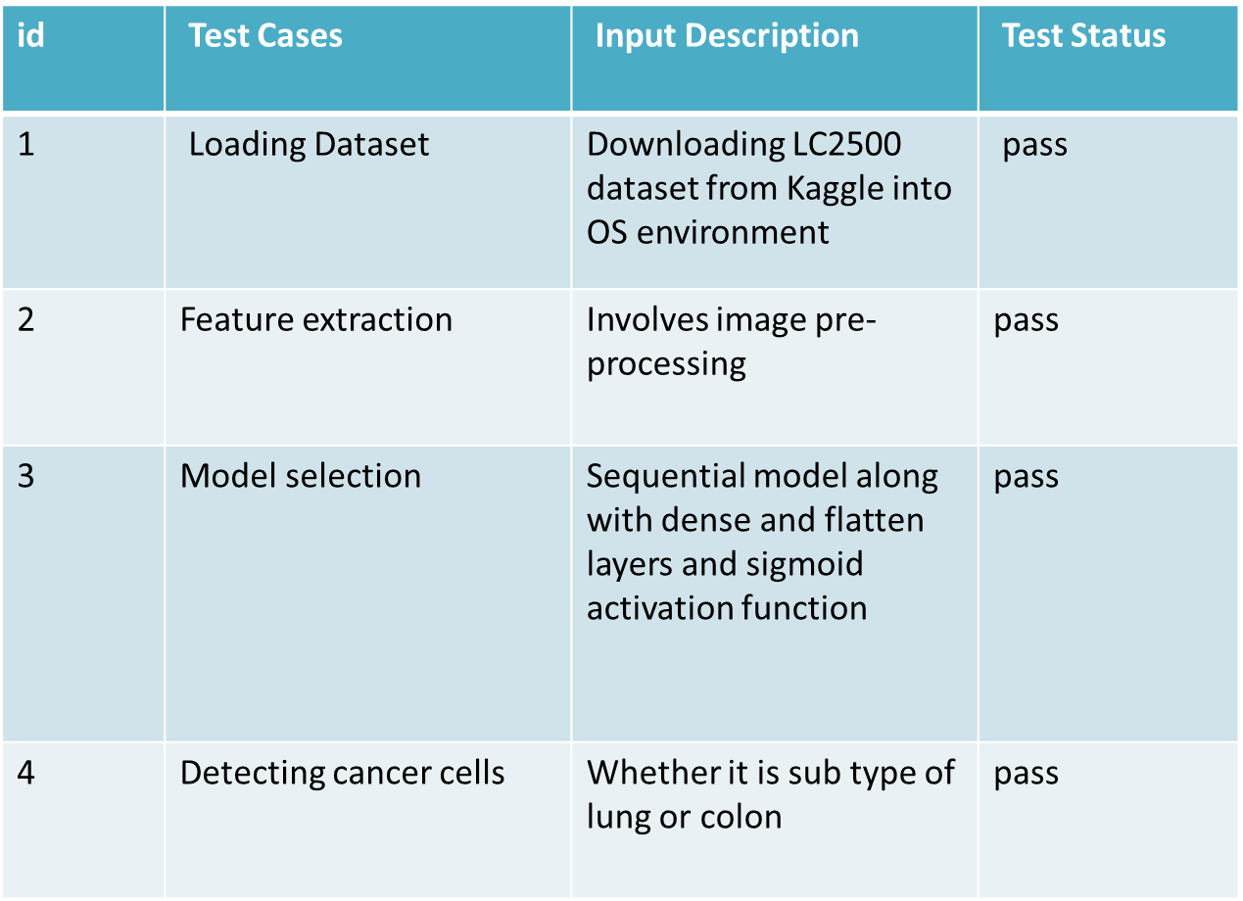
Evaluation/Testing

Slide 22
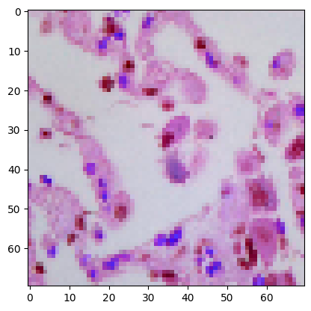
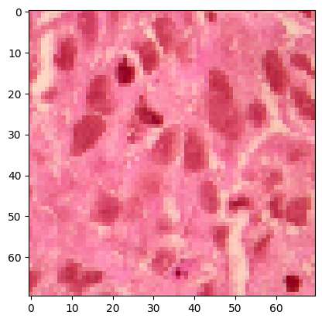
Sample Test Cases
Before:
After:
Predict val: lung_scc
Real val : lung_scc

Slide 23
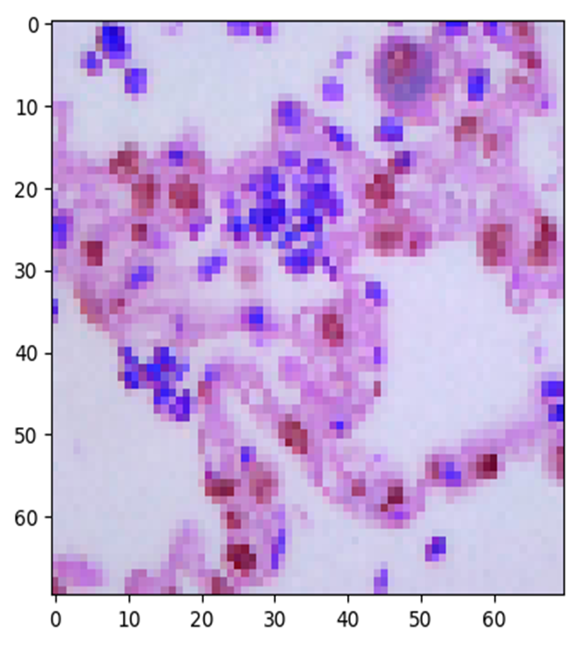
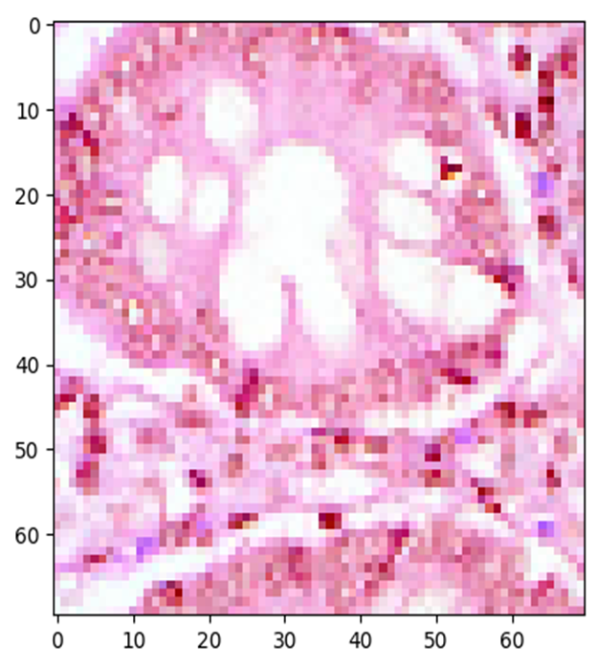
Sample Test Cases
Before:
After:
Predict val : Colon_aca
Real val : colon_aca

Slide 24
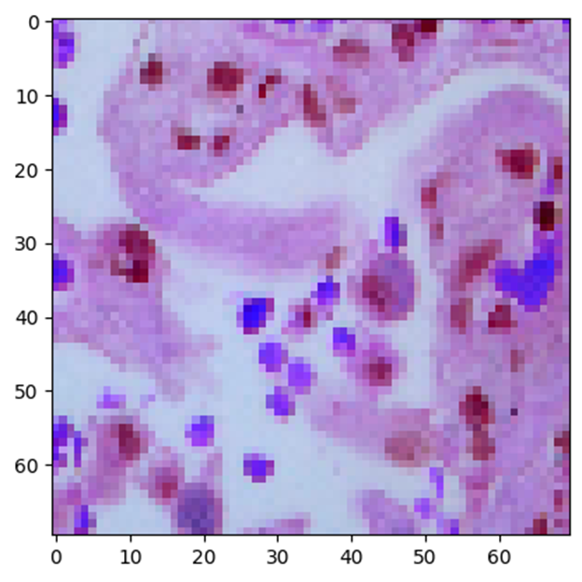
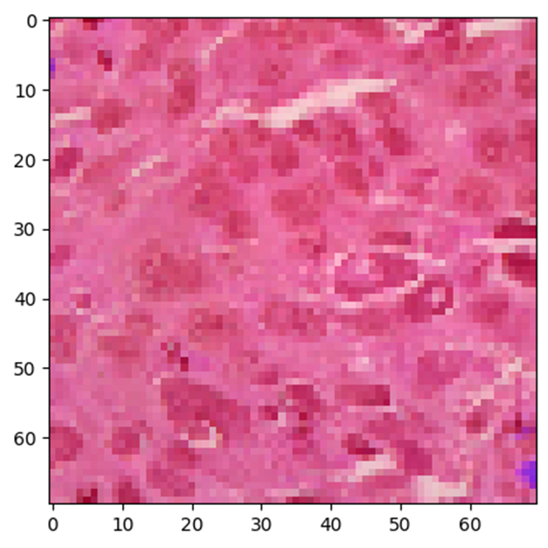
Sample Test Cases
Before:
After:
Predict val: lung_aca
Real val : lung_aca

Slide 25
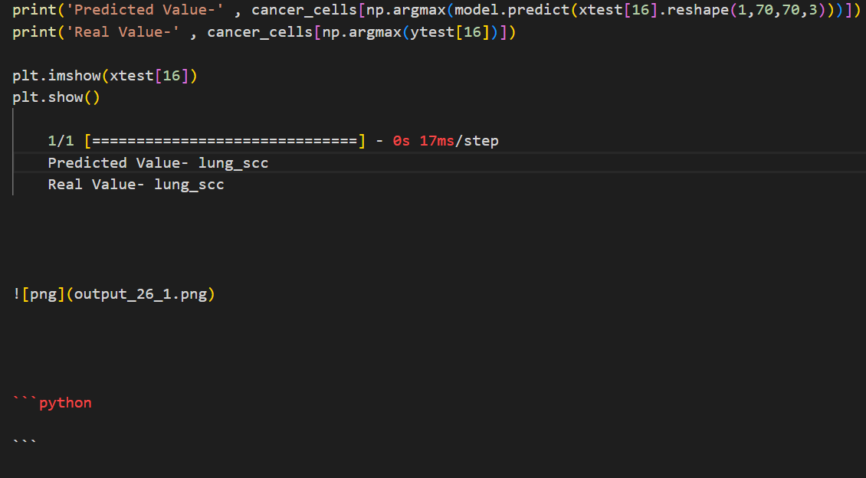

Outputs/Results
Output1:

Slide 26
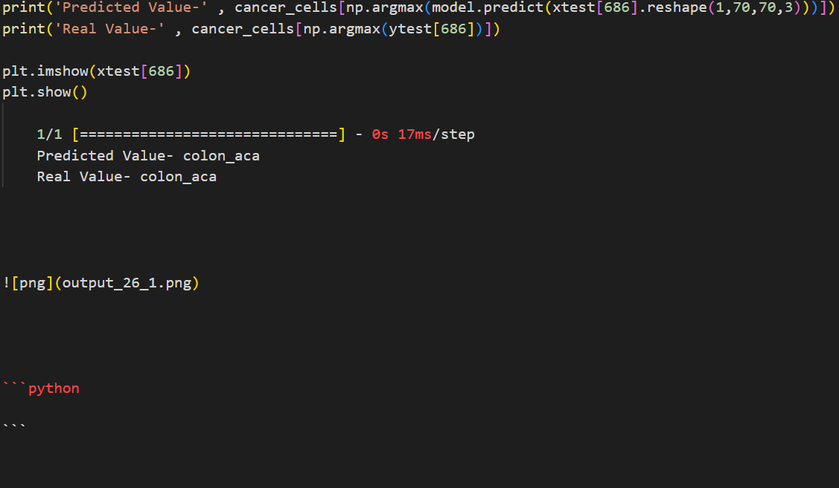
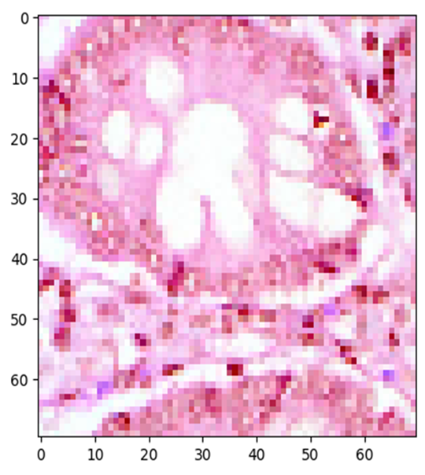
Outputs/Results
Output1:

Slide 27
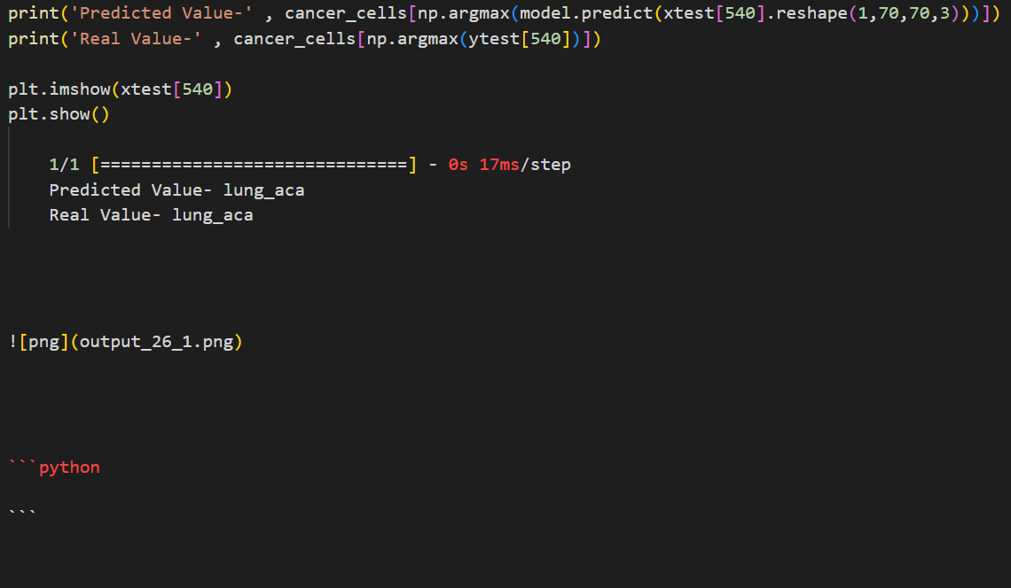
Outputs/Results
Output1:

Slide 28
Conclusion
This project presented a hybrid model for lung and colon cancer detection that integrates pre-processing, feature extraction using CNN model and detects the image belongs to which type of cancer cells.
Image pre-processing, deep feature extraction, optimizer, and confusion matrix have all been discussed.
Based on this Patient can have the chance for early diagnosis of the cancer that can lead to decrease overall death rates in world.

Slide 29
Future Enhancements
In Future we can predict with different Hybrid Models which can leads to higher success rate
Early prediction can decreases the death rates especially caused by cancer. So, By this model we can implement in hospitals for early detection of cancer.
In future we can able to detect the cancer cells in other body parts as well with higher success rate.

Slide 30
References
1. Abbasi, A. A., Hussain, L., Awan, I. A., Abbasi, I., Majid, A., Nadeem, M. S. A., and Chaudhary, Q.-A. (2020). Detecting prostate cancer using deep learning convolution neural network with transfer learning approach. Cognitive Neurodynamics, 14(4):523–533.
2. Abdelsamea, M. M., Pitiot, A., Grineviciute, R. B., Besusparis, J., Laurinavicius, A., and Ilyas, M. (2019). A cascade-learning approach for automated segmentation of tumour epithelium in colorectal cancer. Expert Systems with Applications, 118:539–552.
3. Adeoye, J., Hui, L., Koohi-Moghadam, M., Tan, J. Y., Choi, S.-W., and Thomson, P. (2022). Comparison of timeto-event machine learning models in predicting oral cavity cancer prognosis. International journal of medical informatics, 157:104635.
4. Adu, K., Yu, Y., Cai, J., Owusu-Agyemang, K., Twumasi, B. A., and Wang, X. (2021). Dhs-capsnet: Dual horizontal squash capsule networks for lung and colon cancer classification from whole slide histopathological images. International Journal of Imaging Systems and Technology.
5. Ahsan, M., Gomes, R., Chowdhury, M., Nygard, K. E., et al. (2021). Enhancing machine learning prediction in cybersecurity using dynamic feature selector. Journal of Cybersecurity and Privacy, 1(1):199–218.

Slide 31
References
6. Alkhatib, K. and Abualigah, S. (2020). Predictive model for cutting customers migration from banks: Based on machine learning classification algorithms. In 2020 11th International Conference on Information and Communication Systems (ICICS), pages 303–307. IEEE.
7. Alsinglawi, B., Alshari, O., Alorjani, M., Mubin, O., Alnajjar, F., Novoa, M., and Darwish,O. (2022). An explainable machine learning framework for lung cancer hospital length of stay prediction. Scientific reports, 12(1):1–10.
8. Assegie, T. A. (2021). An optimized k-nearest neighbor based breast cancer detection.Journal of Robotics and Control (JRC), 2(3):115–118.
9. Baldi, P. (2018). Deep learning in biomedical data science. Annual review of biomedical data science, 1:181–205.
10. Bansal, M., Kumar, M., Sachdeva, M., and Mittal, A. (2021). Transfer learning for image classification using vgg19: Caltech-101 image data set. Journal of Ambient Intelligence and Humanized Computing, pages 1–12

Slide 32


